Slide 1
ICN – all the right connections
Albury
January 30 2020
Notes:
The main purpose of this slide is for the audience to remember ICN and our logo. For that reason, it’s best no to clutter it up with a lot of information like dates, places, etc. The audience knows where they are and the date so this should be less important than your name, title etc

Slide 2
ICN – Industry Capability Network
ICN
The benefits of working with us
Register your business
Notes:
‘Today I’m going to talk you about ICN (who we are and what we do), the benefits of working with us as a supplier and why it’s important register your business on ICN Gateway’

Slide 3
Service Offering
Buyers:
What do we do:
Assist the buyer to identify capable local, Indigenous and social enterprises.
How do we do it:
ICN Gateway project web pages and communication of project information/ supply opportunities
Supply chain mapping
Supplier briefings
Suppliers:
What do we do:
Inform suppliers about projects and how to position themselves for supply opportunities.
How do we do it:
Support businesses to create company profiles and register interest against supply opportunities on ICN Gateway.

Slide 4
ICN Gateway
URL: https://gateway.icn.org.au
Web portal for buyers and suppliers
Suppliers create and manage a company profile (CV)
Buyers communicates project information and supply opportunities.
Suppliers register their interest for supply opportunities (EOI)
A guide to assist with profiles and EOI registration called ICN NSW Gateway Guide 2019 will be sent
Notes:
ICN Gateway
* Who here in the room has heard of ICN Gateway?
Home page
ICN Gateway home page serves multiple purposes
1. You can create a new company profile
2. Login to an existing company profile
3. Search for suppliers (businesses that have subscribed to one of three paid packages
4. You can look for work (i.e. Inland Rail)

Slide 5
Company Profiles - Subscriptions
‘Free’ or paid subscriptions available.
‘Free’ profiles have full access to ICN Gateway project pages and can register interest in all supply opportunities.
Paid subscriptions provide businesses with additional promotional benefits (e.g. public listing on ICN Gateway).

Slide 6
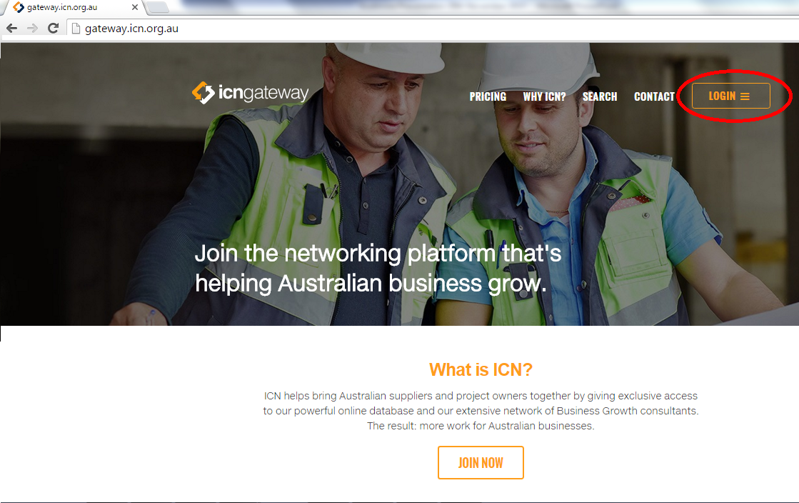

Slide 7
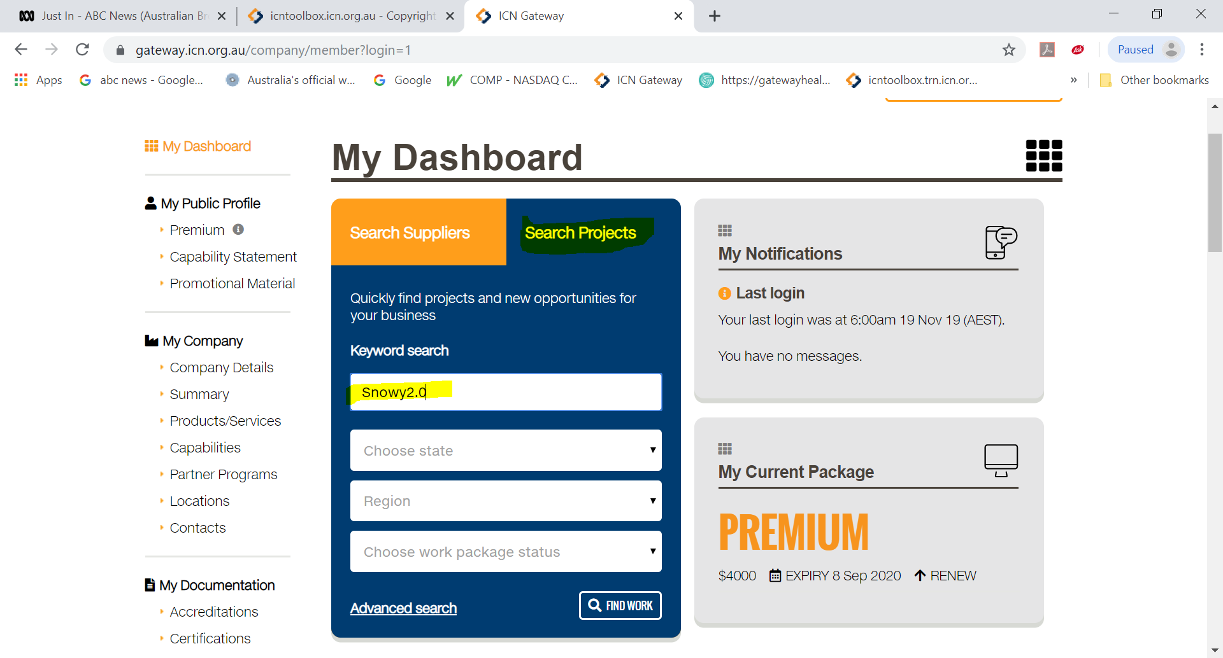
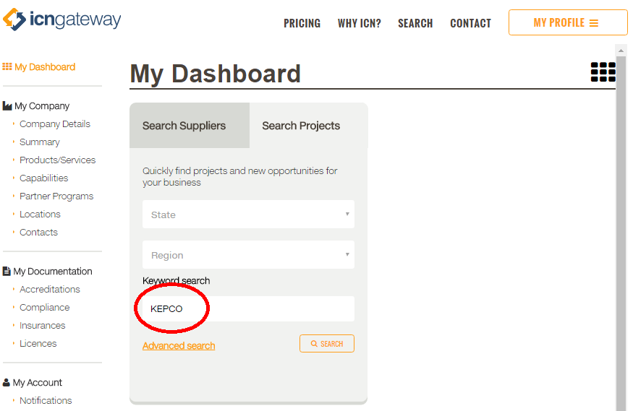
Scroll down to…
Notes:
This slide lists some of the major (and active projects) on ICN Gateway at the moment. If there are other projects that better suit your audience, feel free to edit this slide to include those (and delete those that aren’t relevant).

Slide 8
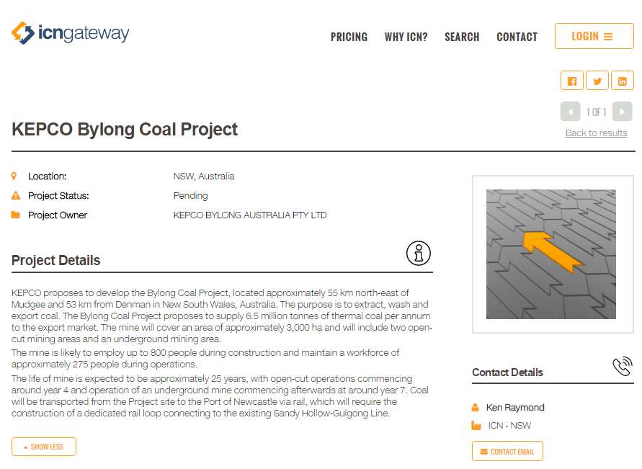
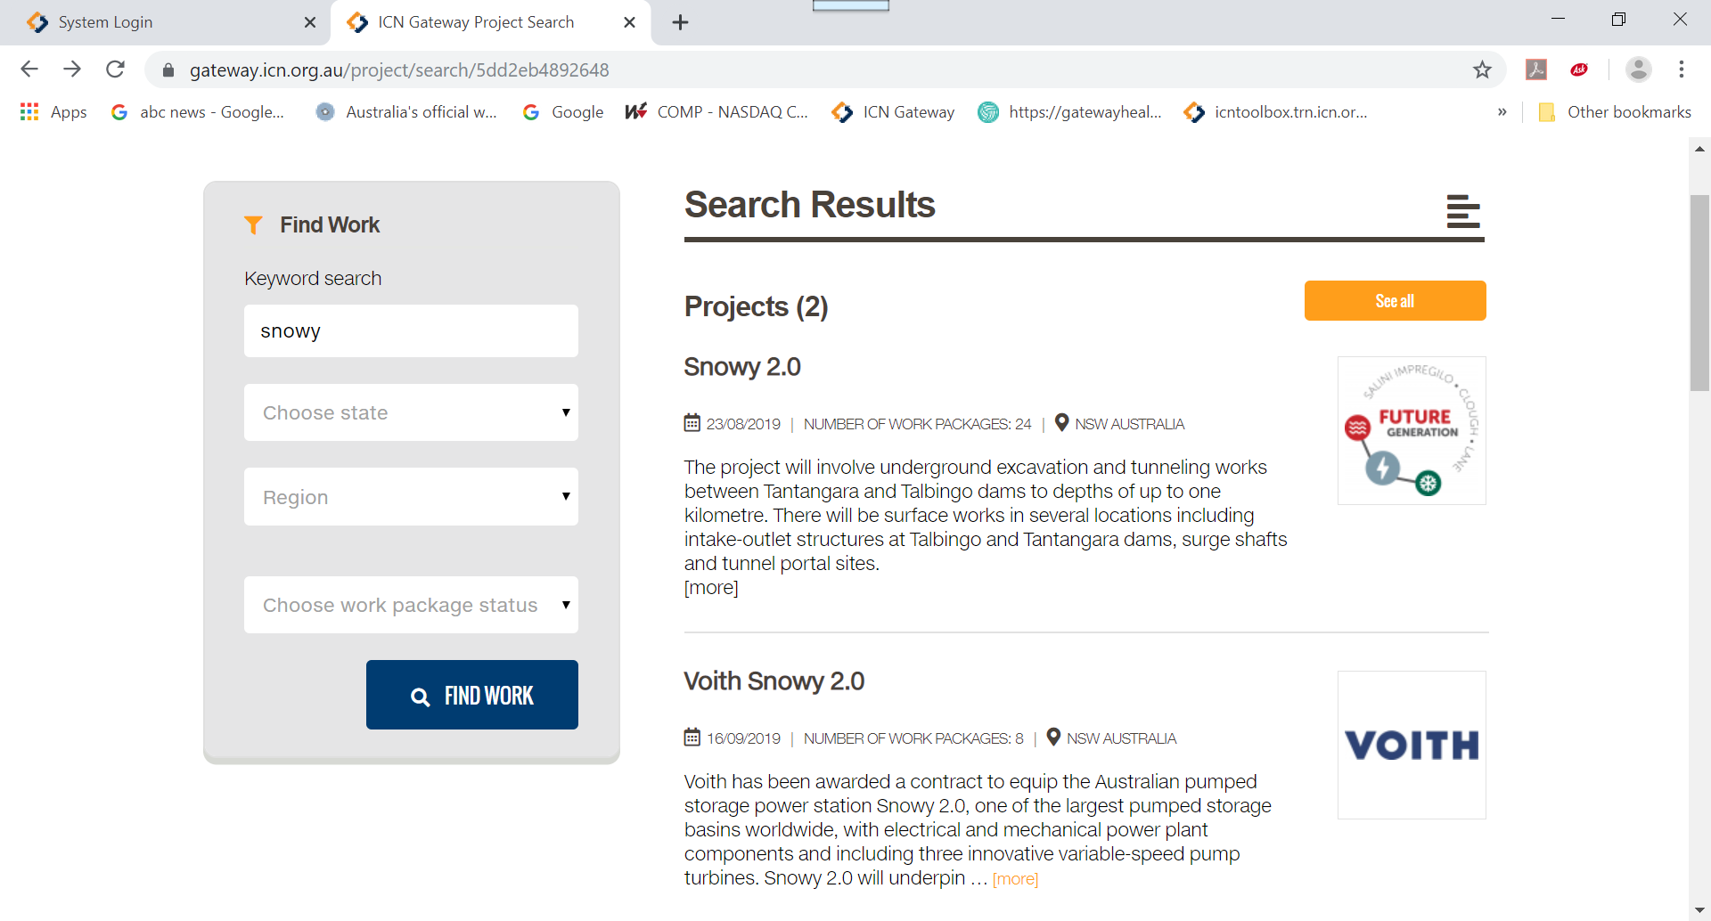

Slide 9
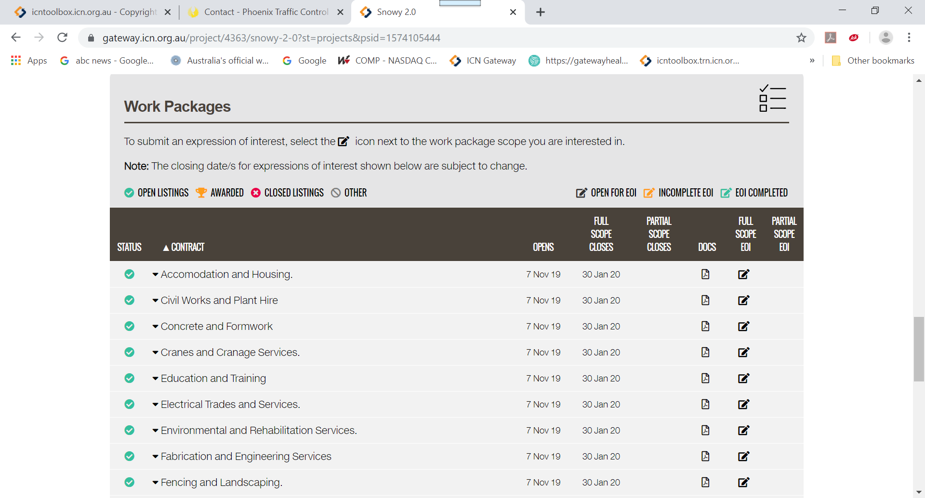
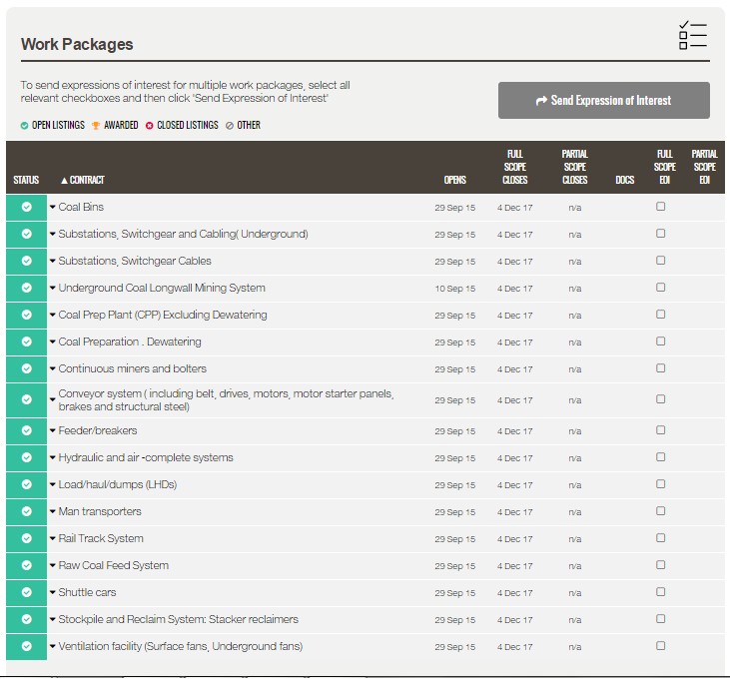

Slide 10
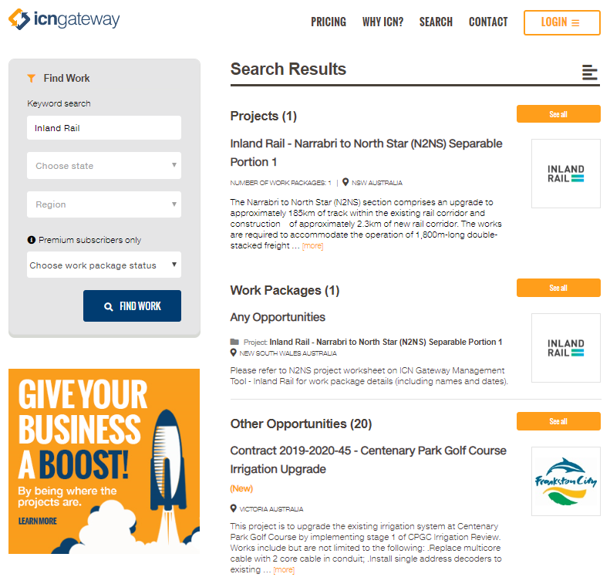
Inland Rail – Narrabri to North Star-SP1
Type ‘Inland Rail’ in to keyword search
Select project from selection available.

Slide 11
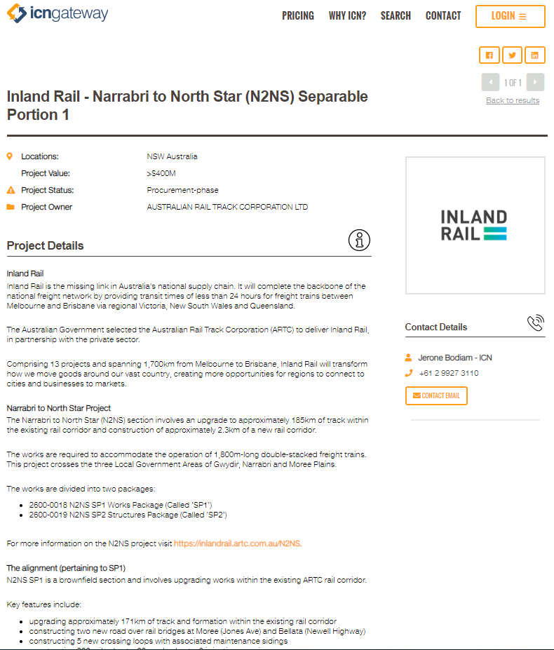
Inland Rail – Narrabri to North Star-SP1
Project
Name
Location
Value
Status
Owner
Details
ICN consultant’s contact details

Slide 12
Inland Rail – Narrabri to North Star-SP1
Check the Status
Select the Work Package
Check the open and close dates
Select ‘Full Scope EOI’ or ‘Partial Scope EOI’

Slide 13
Tips for your Company Profile
Refer to the ICN NSW Gateway Guide 2019
Include all company and business names
Concise Summary
Include differentiators
Include all keywords
List products and services in detail, including side lines
List all facilities and equipment
Enter as much details as possible as profile auto fills part of the EOI

Slide 14
Next steps / Where to from here
ICN Gateway company profile
- Create a new company profile or ensure existing company profile is complete, up-to-date and accurate.
Elect to receive notifications about supply opportunities
Register your interest against supply opportunities your business has the capability to deliver
Attend capability development programs and networking events to improve your chances of success.

Slide 15
Klaus Baumgartel
klausb@icnnsw.org.au
Mob: 0412 595 897

