Slide 1
ICN Workshops, Wagga Wagga and Albury
Ben Hughes |
Future Generation Joint Venture |
29 and 30 January 2020|

Slide 2
Project Overview

Slide 3
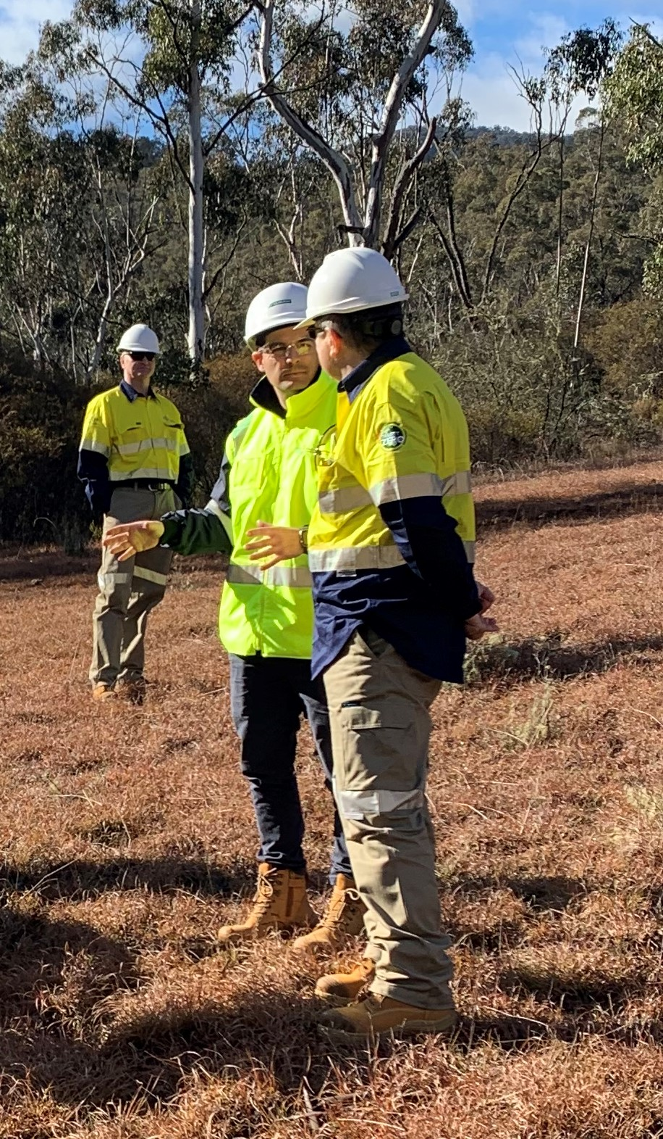
Meet Future Generation Joint Venture
Future Generation is a unique partnership created to deliver Snowy 2.0 on behalf of Snowy Hydro Limited.
Combined engineering experience of 3 companies:
Australian-based Clough
Italy’s Salini Impregilo
US-based Lane Construction
Partnering with German-based Voith Hydro

Slide 4
Future Generation Joint Venture
Project team pairs local expertise with global experience.
Culturally diverse and bring different perspectives and experiences to our design and construction solutions.
Combined experience over 200 years of global and Australian experience in hydro power and tunnelling construction.
Hydroelectric – Water – Tunnelling – Remote – Shafts – Electrical & Mechanical

Slide 5
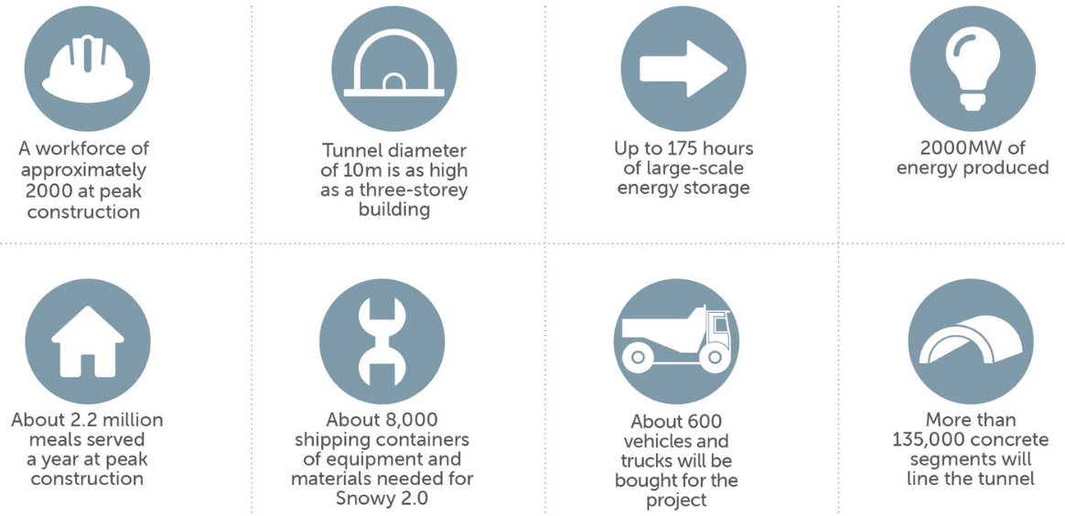
Construction key facts

Slide 6
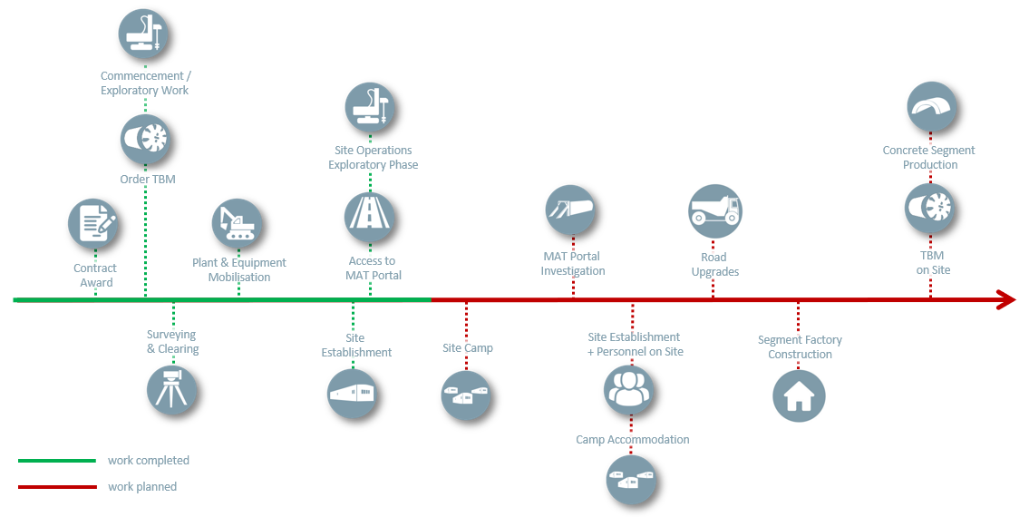
Snowy 2.0 Construction Program for 2019/2020

Slide 7
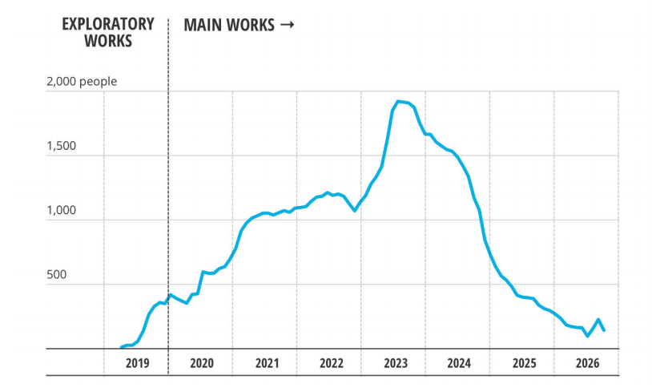
Snowy 2.0 workforce requirements

Slide 8
Contact Us
Future Generation Joint Venture
futuregenerationjv.com.au
Community Infoline: 1300 766 992
Project Office: 220-226 Sharp Street Cooma NSW 2630
community@futuregenerationjv.com.au
business@futuregenerationjv.com.au
recruiting@futuregenerationjv.com.au

Slide 9
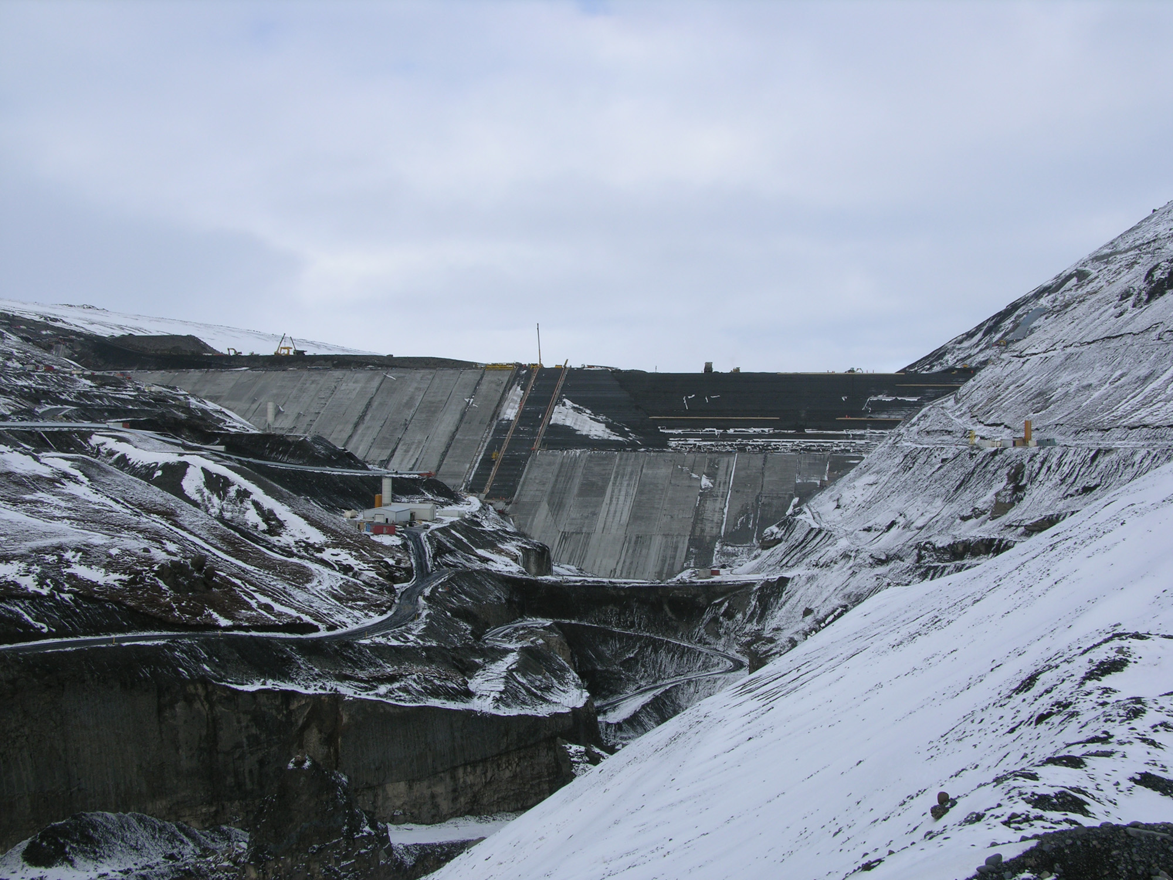
SNOWY 2.0
Thank you.

