Slide 1

Training Services NSW
Role and Services
ICN Profile Workshops for Snowy 2.0 and Inland Rail
Wagga - Wednesday, 29th January 2020
Albury - Thursday, 30th January 2020

Slide 2
Training Services NSW – Our Role & Services
Leads strategic policy, planning, funding, regulation and advice on VET to support economic, regional and community development.
Responsible for government funded vocational education and training (VET) in NSW
Responsible for the implementation of funding programs including Smart and Skilled, apprenticeships and traineeships and adult and community education.
Undertakes contract management of Smart and Skilled providers including the implementation of quality assurance and performance monitoring.
Has administrative and regulatory functions in relation to the NSW Apprenticeship and Traineeship Act.
Provides a one-stop-shop for vocational education advice, information and services within NSW.
Impartial mediation and dispute resolution support

Slide 3
Training Services NSW
Key role in implementing training provider quality assurance, offering consumer advice and workforce support to local industry and businesses, also regulating apprenticeships and traineeships.
6 Regional and 3 Sydney metropolitan offices.
Supporting 423,000 NSW Government funded students and 160,000 Smart and Skilled students (excluding TAFE students) annually.
Supported 50,000 apprentices and trainees in 2019
https://www.training.nsw.gov.au/
Notes:
TSNSW Regional Operations plays a key role in ….

Slide 4
We can help you design and implement a workforce development strategy
Identifying your training need.
Connecting you with a Registered Training Organisation – a Smart & Skilled provider.
Assist to navigate the many opportunities for support available through Smart & Skilled
Develop work force capability through Targeted Priorities, Pre-Vocational, Part Qualification Program. (TPPPQ)

Slide 5
The NSW Skills List defines the courses government will fund and takes account of state priorities
Entitlement - full qualifications
. Selected Foundation Skills Courses (Certificate I- II)
. Certificate II and III
. Apprenticeships and selected Traineeships
The 2019 Skills List comprises over 700 courses and covers:
Targeted Priorities
. Full qualifications at Certificate IV to Advanced Diploma
. Pre-vocational training
. Part qualifications for priority occupations and sectors
https://www.training.nsw.gov.au/smartandskilled/prices_fees.html

Slide 6
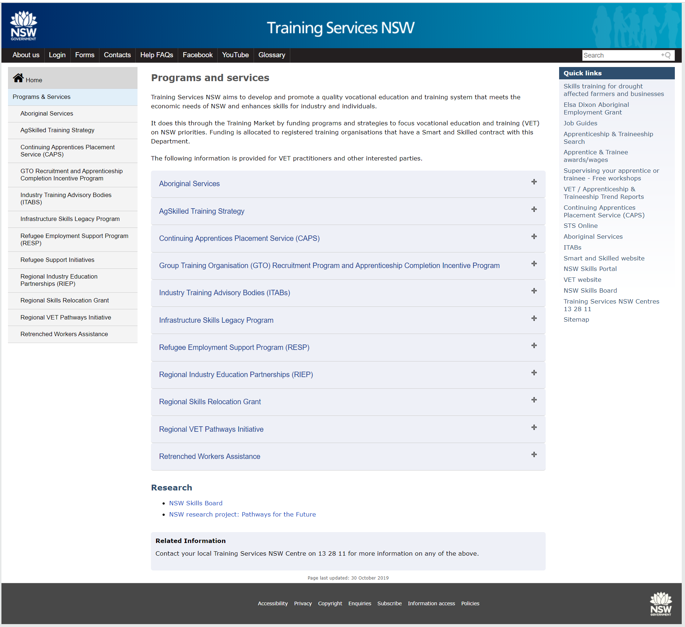

Slide 7

Student Eligibility
Students may be eligible for Smart and Skilled funding if they are:
an Australian citizen, Australian permanent resident, humanitarian visa holder or New Zealand citizen; and
no longer at school; and
living or working in NSW; and
aged 15 years or over

Slide 8
Links
Training Services website https://www.training.nsw.gov.au/index.html
Programs
https://www.training.nsw.gov.au/programs_services/index.html
Fee free Apprenticeships and Traineeships
https://vet.nsw.gov.au/choosing-vet/fee-free-apprenticeships
Smart and Skilled
https://smartandskilled.nsw.gov.au/

Slide 9
Key Contacts – Training Services NSW Riverina
Garry Whittaker
Regional Manager
Garry.Whittaker@det.nsw.edu.au
0458 262 336
Rob Yeo
Training Services Manager
Robert.Yeo@det.nsw.edu.au
0457 536 125
Rick Collins
Training Services Manager
Rick.Collins@industry.nsw.gov.au
0438 172 234
Angela Rey
Training Coordinator
Angela.Rey1@det.nsw.edu.au
0477 343 338
Stacey Suidgeest
Training Coordinator
Stacey.Suidgeest@det.nsw.edu.au
0477 341030
Rob Dickins
Training Advisor - Albury
Rob.Dickins2@det.nsw.edu.au
0427 559 564

